Slide 1
TABLEAU DATAVIZ CHALLENGE 2021
File created on: 27-04-2021 16:27:55

Slide 3
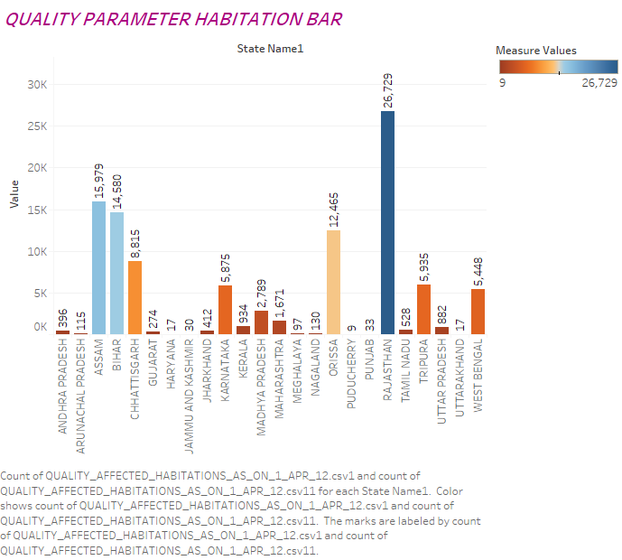

Slide 5
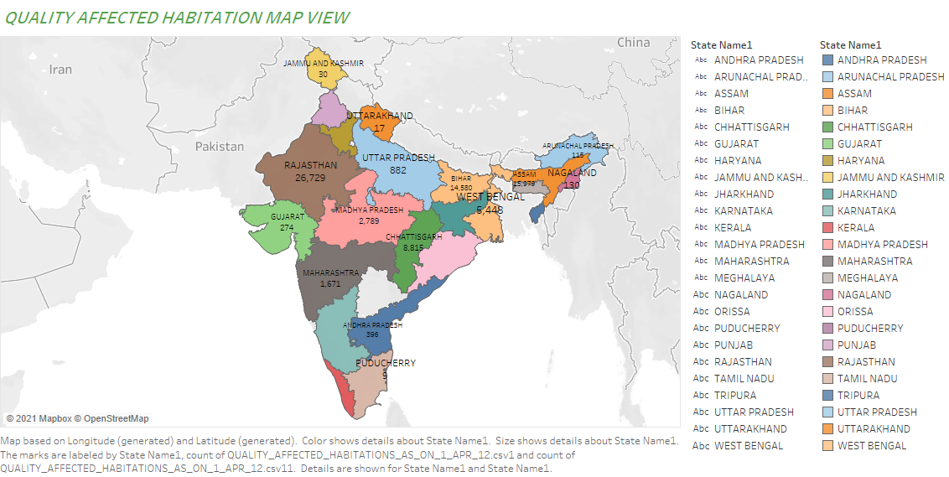

Slide 6
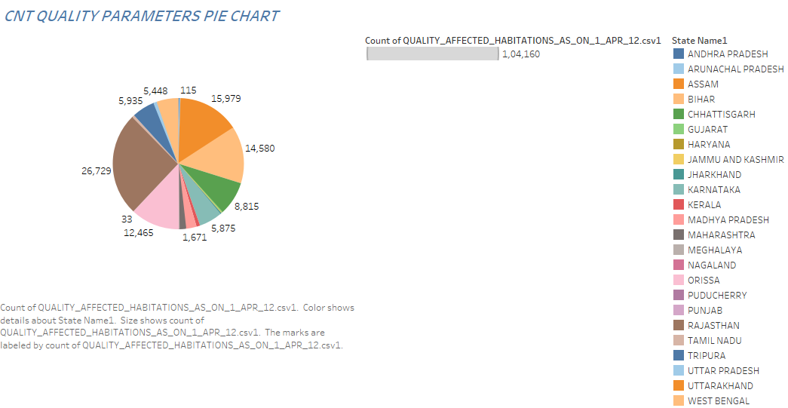

Slide 7


Slide 8
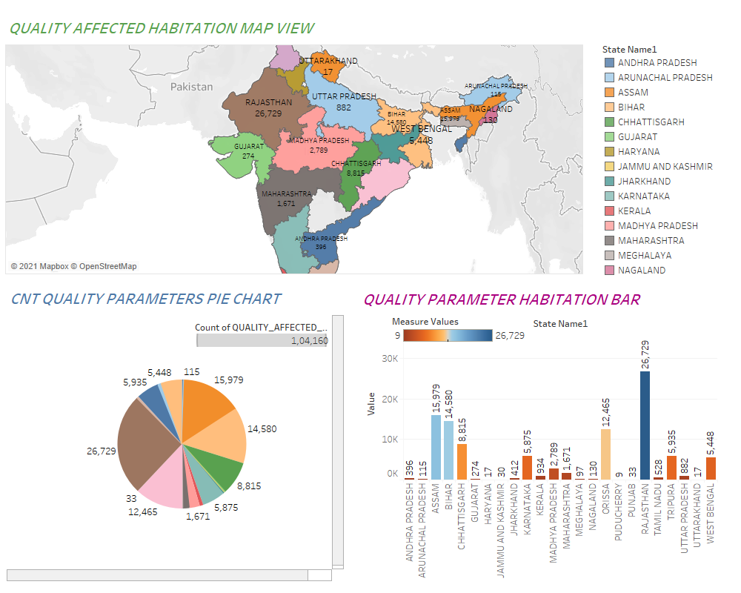

Slide 9
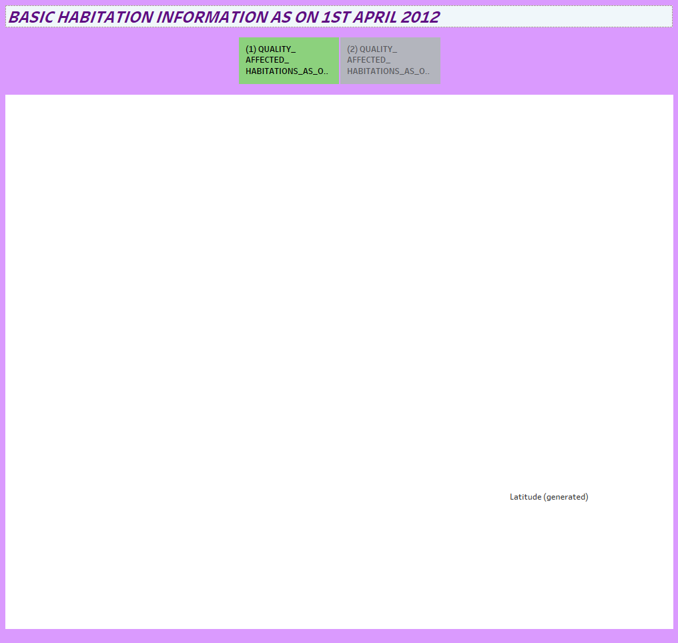

Slide 10
